Slide 1
Relational Model / Relational Algebra
Structure of Relational Databases
Relational Algebra
Tuple Relational Calculus
Domain Relational Calculus
Extended Relational-Algebra-Operations
Modification of the Database
Views

Slide 2
Banking Example
branch (branch-name, branch-city, assets)
customer (customer-name, customer-street, customer-only)
account (account-number, branch-name, balance)
loan (loan-number, branch-name, amount)
depositor (customer-name, account-number)
borrower (customer-name, loan-number)

Slide 3
Example Queries
Find all loans of over $1200
_{amount > 1200} (loan)
Find the loan number for each loan of an amount greater than
$1200
_{loan-number} (_{amount} _{> 1200} (loan))

Slide 4
Example Queries
Find the names of all customers who have a loan, an account, or both, from the bank
  _{customer-name} (borrower)  _{customer-name} (depositor)
Find the names of all customers who have a loan and an
account at bank.
  _{customer-name} (borrower)  _{customer-name} (depositor)

Slide 5
Example Queries
Find the names of all customers who have a loan at the Perryridge branch.
_{customer-name} (_{branch-name=“Perryridge”}
(borrower.loan-number = loan.loan-number(borrower x loan)))
Find the names of all customers who have a loan at the
Perryridge branch but do not have an account at any branch of
the bank.
_{customer-name} (_{branch-name = “Perryridge”}
(borrower.loan-number = loan.loan-number(borrower x loan))) –
_{customer-name}(depositor)

Slide 6
Example Queries
Find the names of all customers who have a loan at the Perryridge branch.
  Query 1
  _{customer-name}(_{branch-name = “Perryridge”} (
  borrower.loan-number = loan.loan-number(borrower x loan)))
  − Query 2
  _{customer-name}(loan.loan-number = borrower.loan-number(
  (_{branch-name = “Perryridge”}(loan)) x borrower))

Slide 7
Example Queries
Find the largest account balance
Rename account relation as d
The query is:
_{balance}(account) - _{account.balance}
(_{account.balance < d.balance} (account x ρ_{d} (account)))

Slide 8
Formal Definition
A basic expression in the relational algebra consists of either one of the following:
  A relation in the database
  A constant relation
Let E₁ and E₂ be relational-algebra expressions; the following are all relational-algebra expressions:
  E₁ ∪ E₂
  E₁ - E₂
  E₁ x E₂
  σ_{p} (E₁), P is a predicate on attributes in E₁
  ∏_{s}(E₁), S is a list consisting of some of the attributes in E₁
  ρ _{x} (E₁), x is the new name for the result of E₁

Slide 9
Additional Operations
We define additional operations that do not add any power to the
relational algebra, but that simplify common queries.
Set intersection
Natural join
Division
Assignment

Slide 10
Set-Intersection Operation
Notation: r ∩ s
Defined as:
r ∩ s ={ t | t ∈ r and t ∈ s }
Assume:
  r, s have the same arity
  attributes of r and s are compatible
Note: r ∩ s = r - (r - s)

Slide 11
Set-Intersection Operation - Example
Relation r, s:
r ∩ s
A B
A B



1
2
1


2
3
r
s
A B
 2

Slide 12
Natural-Join Operation
Notation: r s
Let r and s be relations on schemas R and S respectively.
Then, r s is a relation on schema R ∪ S obtained as follows:
  Consider each pair of tuples t_{r} from r and t_{s} from s.
  If t_{r} and t_{s} have the same value on each of the attributes in R ∩ S, add a tuple t to the result, where
    t has the same value as t_{r} on r
    t has the same value as t_{s} on s
Example:
  R = (A, B, C, D)
  S = (E, B, D)
  Result schema = (A, B, C, D, E)
  r s is defined as:
  ∏_{r.A, r.B, r.C, r.D, s.E} (σ_{r.B = s.B} ∧ _{r.D = s.D} (r x s))

Slide 13
Natural Join Operation – Example
Relations r, s:
A
B
C
D
B
D
E





1
2
4
1
2





a
a
b
a
b
1
3
1
2
3
a
a
a
b
b





r
s
r s
A
B
C
D
E





1
1
1
1
2





a
a
a
a
b






Slide 14
Division Operation
r  s
Suited to queries that include the phrase “for all”.
Let r and s be relations on schemas R and S respectively where
  R = (A₁, …, A_{m}, B₁, …, B_{n})
  S = (B₁, …, B_{n})
  The result of r ÷ s is a relation on schema
  R – S = (A₁, …, A_{m})
  r ÷ s = { t | t ∈ ∏ _{R-S}(r) ∧ ∀ u ∈ s ( tu ∈ r ) }

Slide 15
Division Operation – Example
A
B
Relations r, s:
B











1
2
3
1
1
1
3
4
6
1
2
1
2
s
r  s:
A
r



Slide 16
Another Division Example
Relations r, s:
A
B
C
D
E
D
E








a
a
a
a
a
a
a
a








a
a
b
a
b
a
b
b
1
1
1
1
3
1
1
1
a
b
1
1
s
r
r  s:
A
B
C


a
a



Slide 17
Division Operation (Cont.)
Property
  Let q – r ÷ s
  Then q is the largest relation satisfying q x s ⊆ r
Definition in terms of the basic algebra operation
Let r(R) and s(S) be relations, and let S ⊆ R
r ÷ s = ∏_{R-S} (r) –∏_{R-S} ( (∏_{R-S} (r) x s) – ∏_{R-S,S}(r))
To see why
  ∏_{R-S,S}(r) simply reorders attributes of r
  ∏_{R-S}(∏_{R-S} (r) x s) – ∏_{R-S,S}(r)) gives those tuples t in
  ∏_{R-S} (r) such that for some tuple u ∈ s, tu ∉ r.

Slide 18
Assignment Operation
The assignment operation (←) provides a convenient way to express complex queries.
  Write query as a sequential program consisting of
    a series of assignments
    followed by an expression whose value is displayed as a result of the query.
  Assignment must always be made to a temporary relation variable.
Example: Write r ÷ s as
temp1 ← ∏_{R-S} (r)
temp2 ← ∏_{R-S} ((temp1 x s) – ∏_{R-S,S} (r))
result = temp1 – temp2
  The result to the right of the ← is assigned to the relation variable on the left of the ←.
  May use variable in subsequent expressions.

Slide 19
Example Queries
Find all customers who have an account from at least the “Downtown” and the Uptown” branches.
  Query 1
    _{CN}(_{BN=“Downtown”}(depositor account)) 
    _{CN}(_{BN=“Uptown”}(depositor account))
  where CN denotes customer-name and BN denotes
  branch-name.
  Query 2
  _{customer-name, branch-name} (depositor account)
   _{temp(branch-name)} ({(“Downtown”), (“Uptown”)})

Slide 20
Example Queries
Find all customers who have an account at all branches located in Brooklyn city.
_{customer-name, branch-name} (depositor account)
 _{branch-name} (_{branch-city = “Brooklyn”} (branch))

Slide 21
Extended Relational-Algebra-Operations
Generalized Projection
Outer Join
Aggregate Functions

Slide 22
Generalized Projection
Extends the projection operation by allowing arithmetic functions to be used in the projection list.
∏ _{F1, F2, …, Fn}(E)
E is any relational-algebra expression
Each of F₁, F₂, …, F_{n} are are arithmetic expressions involving constants and attributes in the schema of E.
Given relation credit-info(customer-name, limit, credit-balance), find how much more each person can spend:
∏customer-name, limit – credit-balance (credit-info)

Slide 23
Aggregate Functions and Operations
Aggregation function takes a collection of values and returns a single value as a result.
avg: average value
min: minimum value
max: maximum value
sum: sum of values
count: number of values
Aggregate operation in relational algebra
_{G1, G2, …, Gn} g _{F1( A1), F2( A2),…, Fn( An)} (E)
  E is any relational-algebra expression
  G₁, G₂ …, G_{n} is a list of attributes on which to group (can be empty)
  Each F_{i} is an aggregate function
  Each A_{i} is an attribute name

Slide 24
Aggregate Operation – Example
Relation r:
A
B
C








7
7
3
10
sum-C
g _{sum(c)} (r)
27

Slide 25
Aggregate Operation – Example
Relation account grouped by branch-name:
branch-name
account-number
balance
Perryridge
Perryridge
Brighton
Brighton
Redwood
A-102
A-201
A-217
A-215
A-222
400
900
750
750
700
_{branch-name} g _{sum(balance)} (account)
branch-name
balance
Perryridge
Brighton
Redwood
1300
1500
700

Slide 26
Aggregate Functions (Cont.)
Result of aggregation does not have a name
  Can use rename operation to give it a name
  For convenience, we permit renaming as part of aggregate operation
_{branch-name} g _{sum(balance) as sum-balance} (account)

Slide 27
Outer Join
An extension of the join operation that avoids loss of information.
Computes the join and then adds tuples form one relation that do not match tuples in the other relation to the result of the join.
Uses null values:
  null signifies that the value is unknown or does not exist
  All comparisons involving null are (roughly speaking) false by definition.
    Will study precise meaning of comparisons with nulls later

Slide 28
Outer Join – Example
Relation loan
loan-number
branch-name
amount
L-170
L-230
L-260
Downtown
Redwood
Perryridge
3000
4000
1700
Relation borrower
customer-name
loan-number
Jones
Smith
Hayes
L-170
L-230
L-155

Slide 29
Outer Join – Example
Inner Join
loan Borrower
loan-number
branch-name
amount
customer-name
L-170
L-230
Downtown
Redwood
3000
4000
Jones
Smith
Left Outer Join
loan Borrower
loan-number
branch-name
amount
customer-name
L-170
L-230
L-260
Downtown
Redwood
Perryridge
3000
4000
1700
Jones
Smith
null

Slide 30
Outer Join – Example
Right Outer Join
loan borrower
loan-number
branch-name
amount
customer-name
L-170
L-230
L-155
Downtown
Redwood
null
3000
4000
null
Jones
Smith
Hayes
Full Outer Join
loan borrower
loan-number
branch-name
amount
customer-name
L-170
L-230
L-260
L-155
Downtown
Redwood
Perryridge
null
3000
4000
1700
null
Jones
Smith
null
Hayes

Slide 31
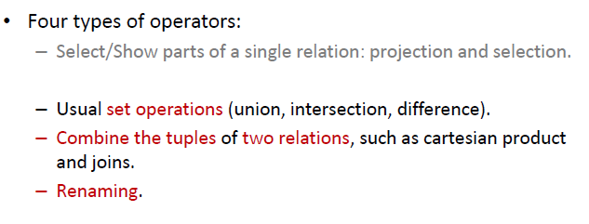
Relational Algebra & SQL

Slide 32
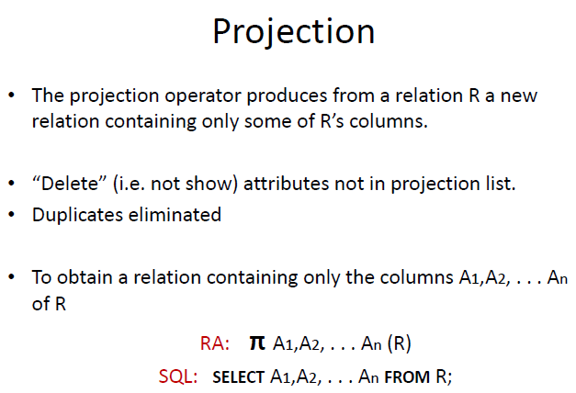

Slide 33
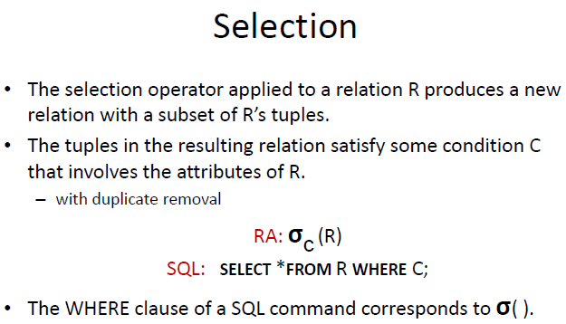

Slide 34
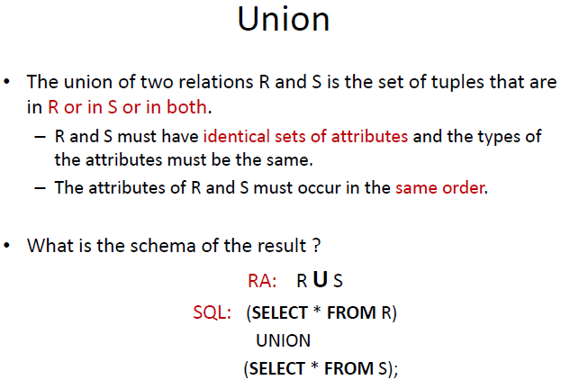

Slide 35
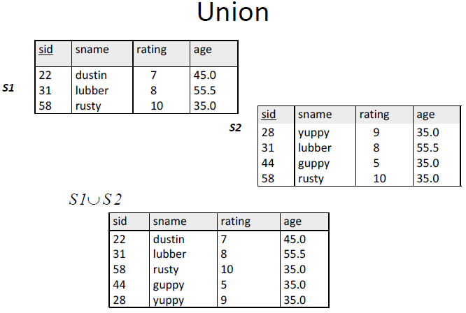

Slide 36
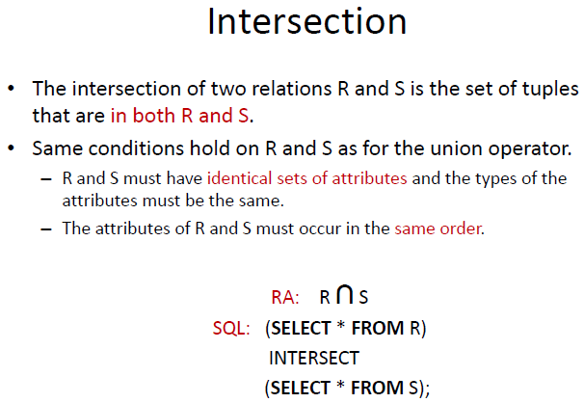

Slide 37
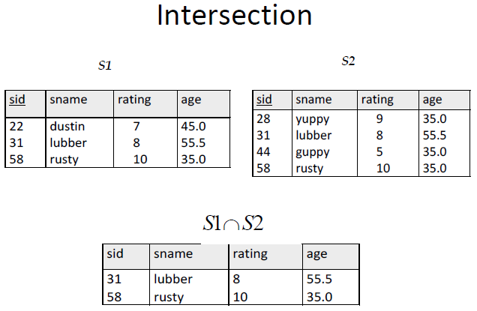

Slide 38
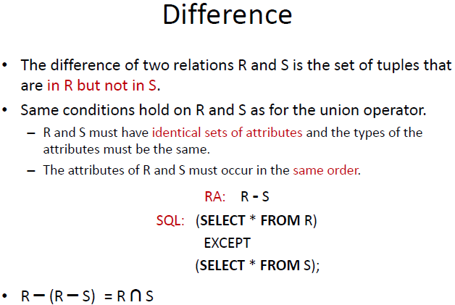

Slide 39
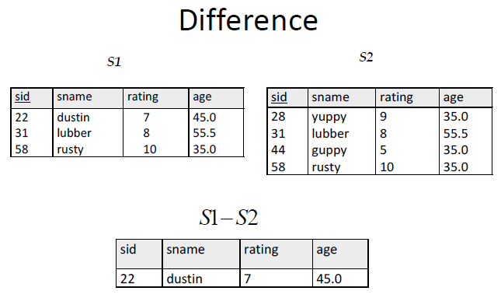

Slide 40
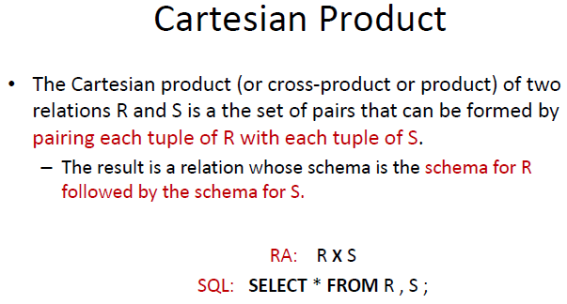

Slide 41
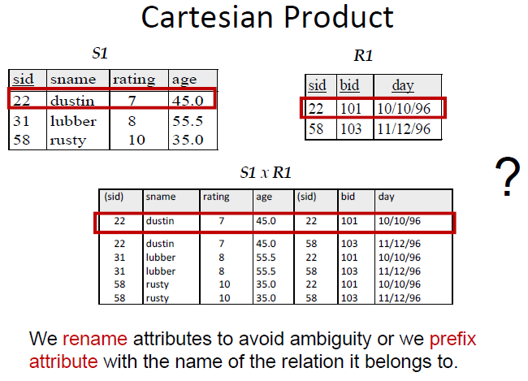

Slide 42
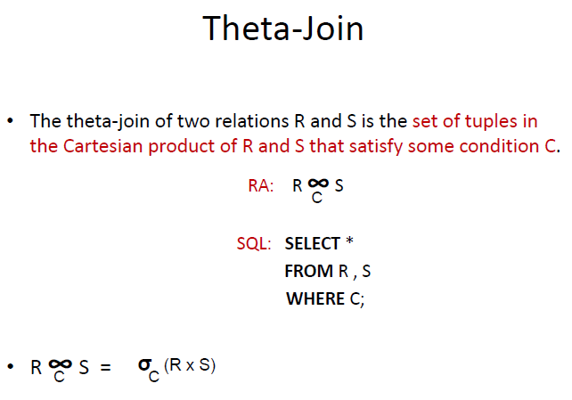

Slide 43
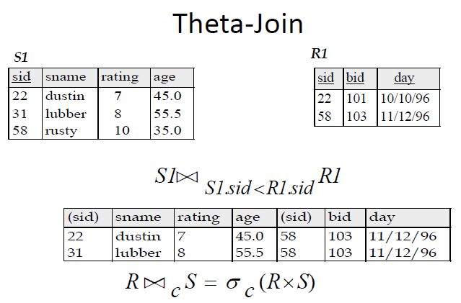

Slide 44
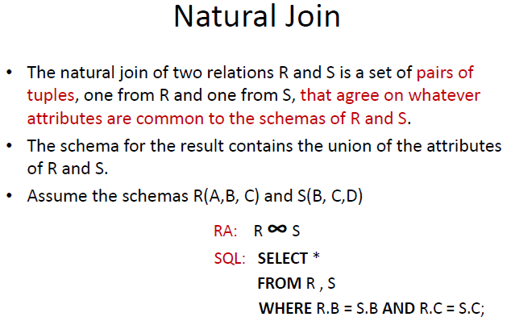

Slide 45
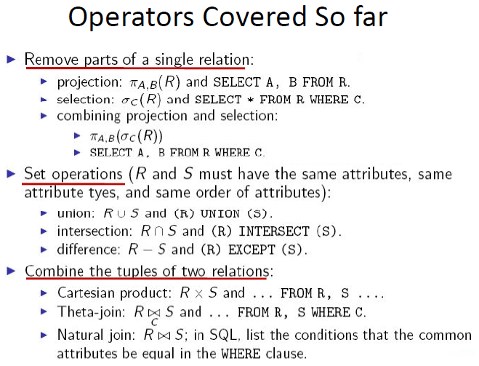

Slide 46
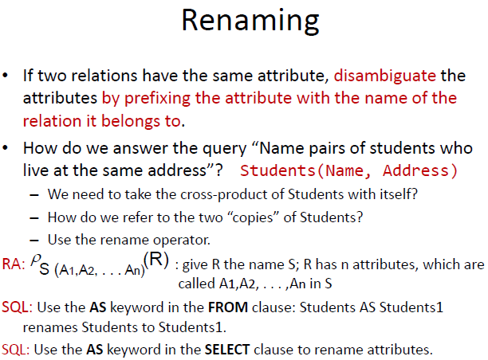

Slide 47
